Slide 1
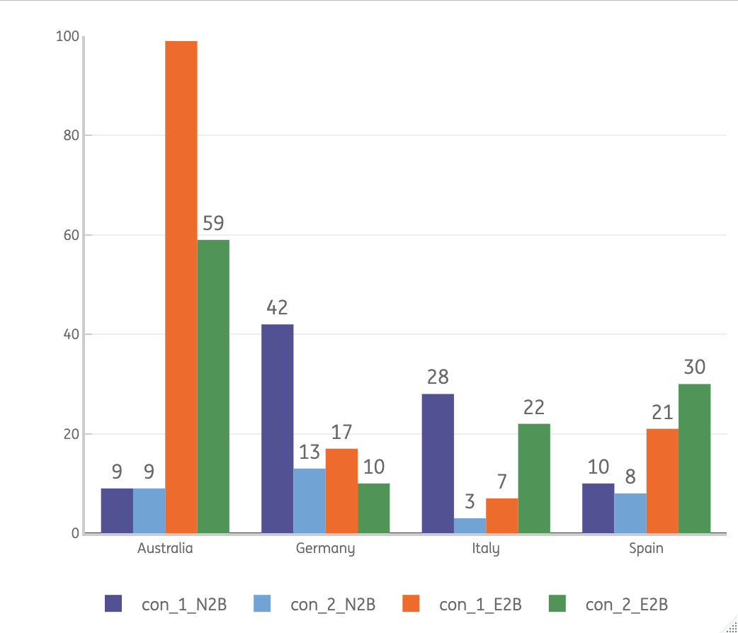
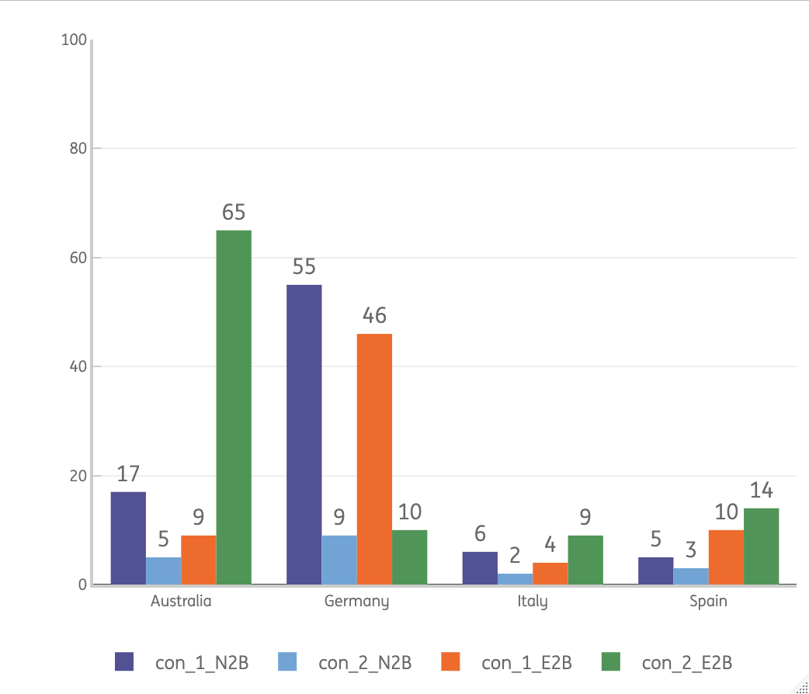
As a benchmark, we explored other ING markets – Germany seems to perform well in converting traffic to the start of application
Mortgage conversion 1 & 2 – Desktop*
Mortgage conversion 1 & 2 – mobile*
Outtake
Germany manages to convert 42% of their traffic to a start of the mortgage flow (starter mortgage);
55% out of these starts submits the form;
Australia is the E2B funnel champ ☺
*Source: QPC – Q4 2022

